Slide 1

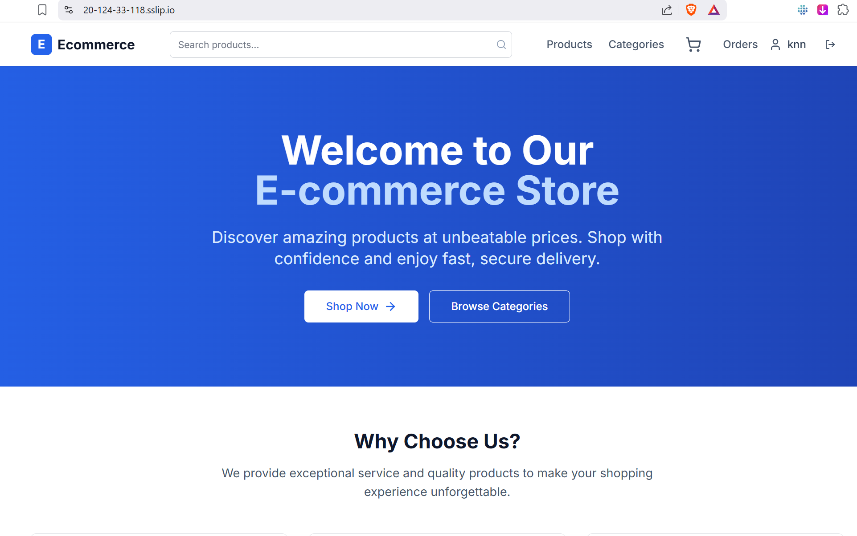


Azure 3-Tier E-Commerce Application
01
Azure 3-Tier
E-Commerce Application
Frontend + Backend + Database on Azure
Secure (HTTPS & Routing)
Scalable (Autoscaling)
Monitored (Logs & Alerts)

Slide 2
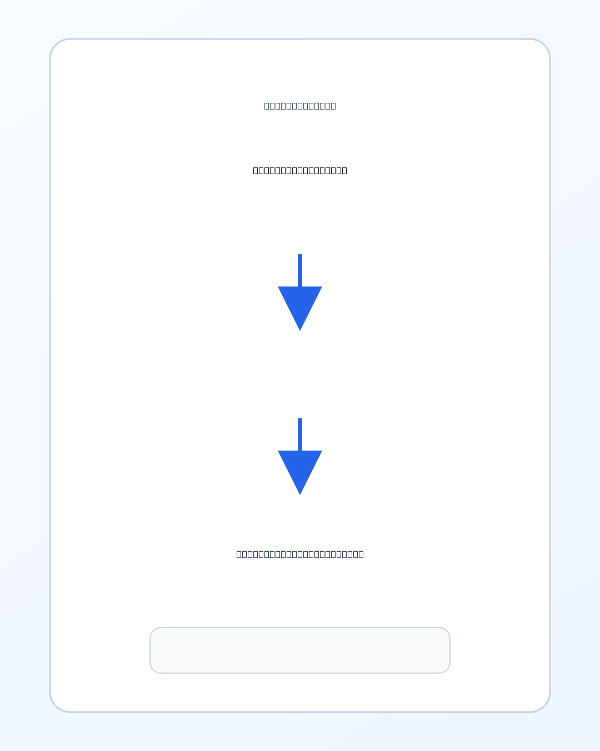



Azure 3-Tier E-Commerce Application
02
Why 3-Tier Architecture?
Presentation Layer
Frontend UI serving the user interface
Application Layer
Backend API processing business logic
Data Layer
Azure SQL Database for data storage

Slide 3
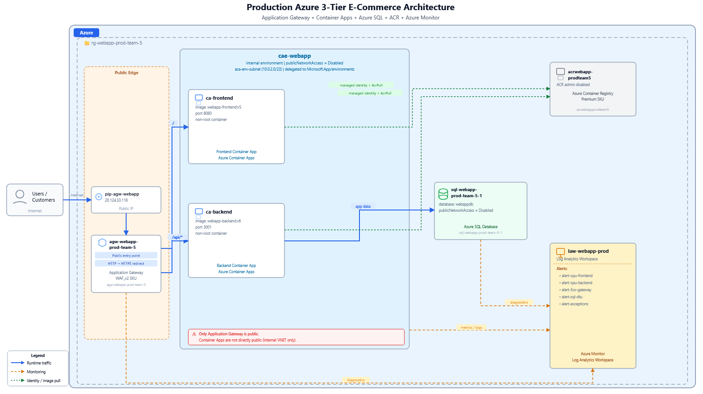


Azure 3-Tier E-Commerce Application
03
Full Azure Architecture
Public Entry
Azure Application Gateway
App Tier
Azure Container Apps
Data Tier
Azure SQL Database
Monitoring
Log Analytics + Alerts

Slide 4
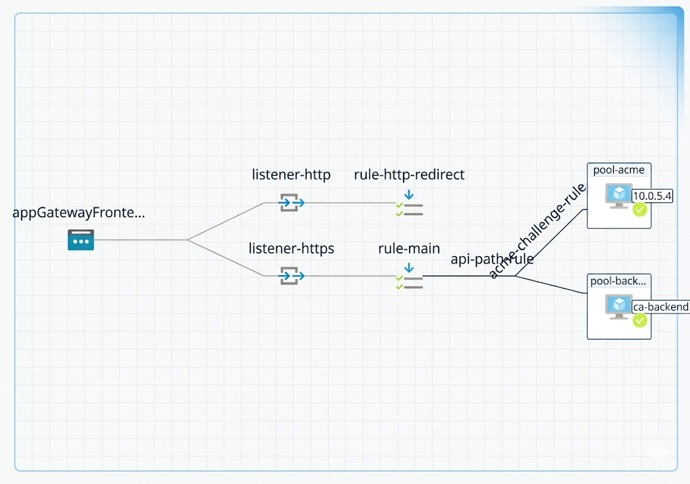
Azure 3-Tier E-Commerce Application
04
Request Flow in the App
1
User opens the website
2
Gateway routes traffic
Backend processes API requests
3
4
SQL stores and returns data

Slide 5


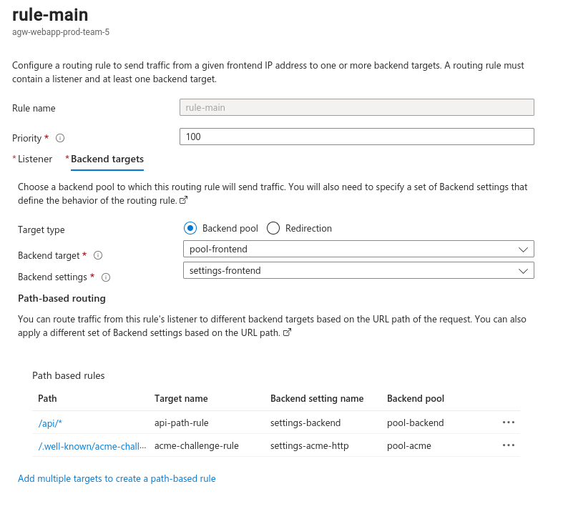
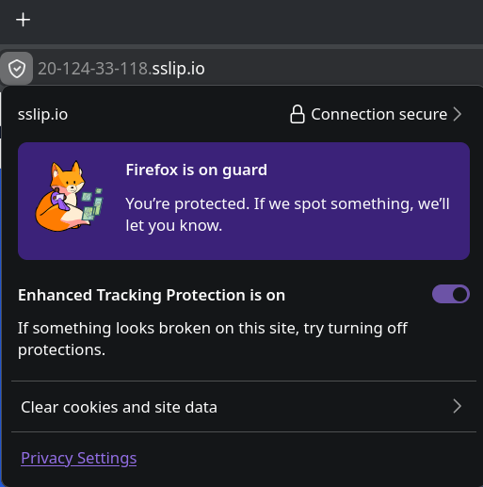



Azure 3-Tier E-Commerce Application
05
Routing Rules
Security & HTTPS
Single public entry point
Encrypted connection
/
→ Frontend
→ Backend
HTTP redirected to HTTPS
/api/*

Slide 6
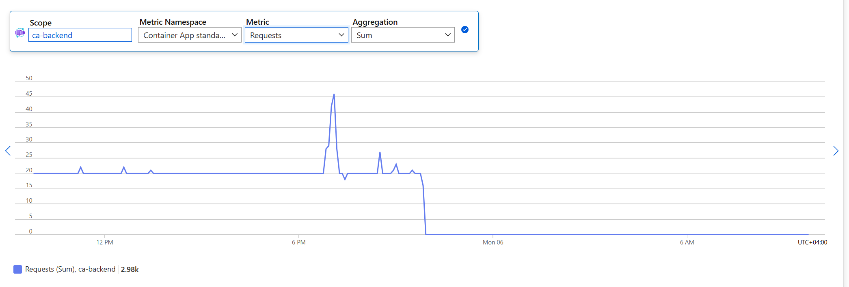
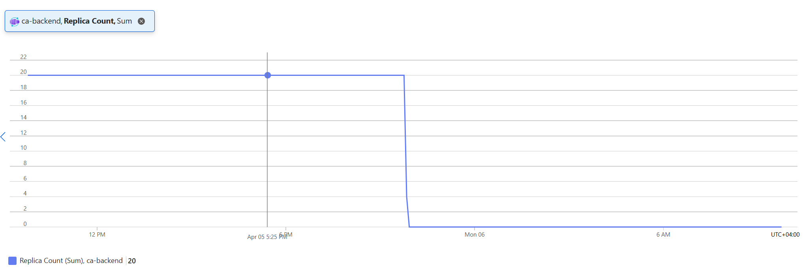
Azure 3-Tier E-Commerce Application
06
When Scaling Happens
Low Traffic
Fewer replicas running to minimize cost
High Traffic
More replicas auto-spawned to handle load
Load Test: Triggered scale-out
Traffic Drop: Triggered scale-in

Slide 7

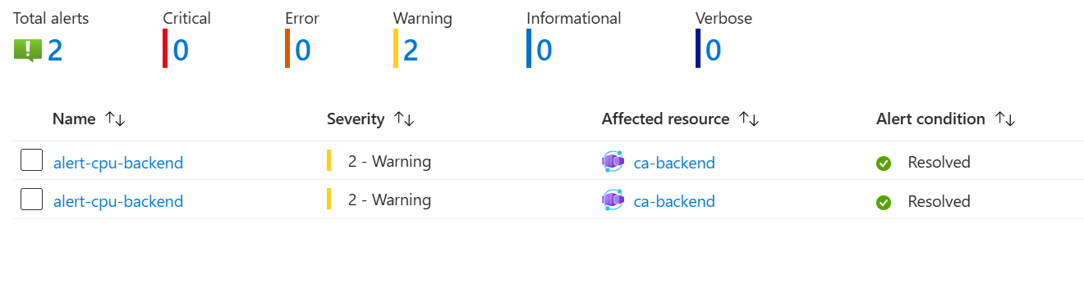

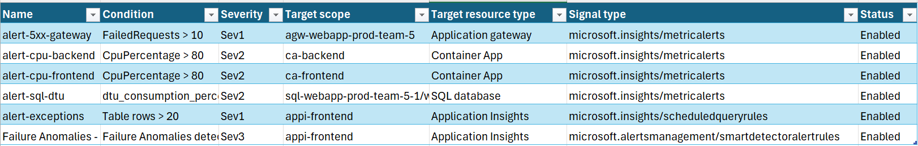
Azure 3-Tier E-Commerce Application
07
Security & Monitoring
Monitoring Alerts
CPU Usage
DTU Limits
Exceptions
5xx Errors
Network Security
Only Application Gateway is public
Container Apps environment is private
SQL public access is disabled

Slide 8

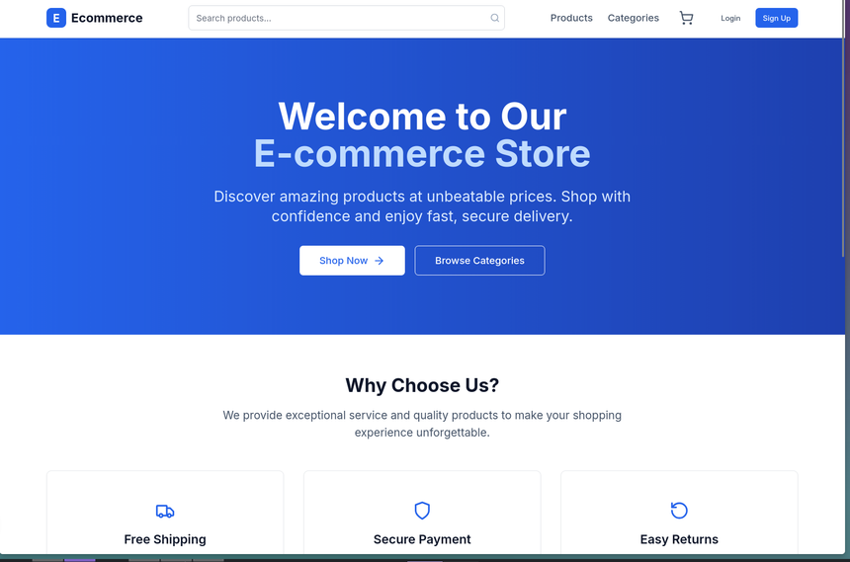
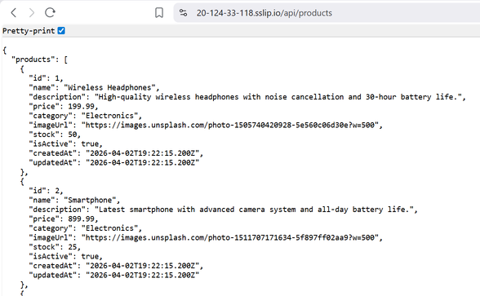
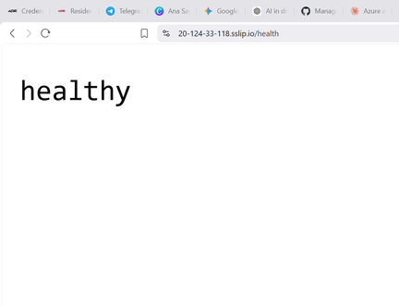
Azure 3-Tier E-Commerce Application
08
Result & Conclusion
Project Success
Autoscaling and monitoring verified
3-tier architecture implemented successfully
HTTPS and routing configured
Production-style Azure deployment completed

Slide 9

Azure 3-Tier E-Commerce Application
08
Thank you for your attention
Team : Kenan Salmanli, Mahammad Mammadov, Fidail Valiyev , Yusif Vatanli

